Slide 1
Power Supply Design
J.SHANMUGAPRIYAN

Slide 2
Outline…
What is Power supply?
Need for Power supply
Elements of Power supply
Filters
Voltage Regulators
A basic Power supply

Slide 3
Why we go for power supply studies?
All electronic circuits need smooth DC power supply in order to function correctly.
The DC power supplied either from battery or power pack units

Slide 4
Contd…
The battery power supply may not be economical
Some other circuits, those using digital ICs, also need their power supply to be regulated.

Slide 5
What is a Power Supply?
A device, which converts, regulates, and transmits the required power to the circuit to be operated

Slide 6
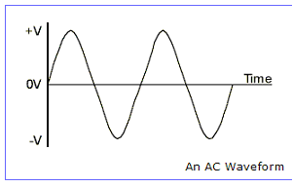
What is AC
The voltage (and current) alternates between positive and negative over time and the resulting waveform shape is a sine wave.

Slide 7
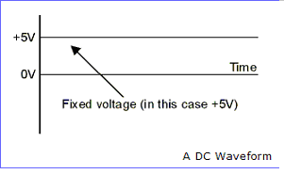
What is DC?
A Direct Current (DC) supply stays at a fixed, regular, voltage all of the time, like the voltage from a battery.

Slide 8
Elements of a Power Supply
Transformer
Rectifier
Filter
Regulator

Slide 9
TRANSFORMER
The AC line voltage available for commercial purpose is not suitable for electronic circuits.
Most of the electronic circuits require a considerably lower voltage

Slide 10
Contd…..
The transformer is a device used to convert the ac line voltage to a voltage level more appropriate to the needs of the circuit to be operated
At the same time, the transformer provides electrical isolation between the ac line and the circuit to be operated.
This is an important safety consideration.

Slide 11
Contd….
The output of the transformer is still an ac voltage, but now of an appropriate magnitude for the circuit to be powered.

Slide 12
Rectifiers
Rectifier is a device which convert AC voltage in to pulsating DC
A rectifier utilizes unidirectional conducting device Ex : P-N junction diodes

Slide 13
Important points to be studied while analyzing the various rectifiers
Rectifier efficiency
Peak value of the current
Peak value of the voltage
Ripple factor

Slide 14
Types
Depending up on the period of conduction
Half wave rectifier
Full wave rectifier
Depending up on the connection procedure
Bridge rectifier

Slide 15
Half wave rectifier
The ripple factor is quite high(1.21)
Rectifier efficiency is very low(40%)
TUF is low(0.21)
The half wave rectifier circuit is normally not used as a power rectifier circuit

Slide 16
Full wave rectifier
Ripple factor is (0.48)
Rectifier efficiency is high(81.2%)
TUF is high(0.693)

Slide 17
Bridge Rectifier
Suitable for applications where large powers are required

Slide 18





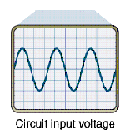
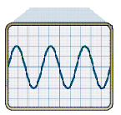
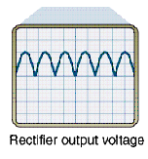
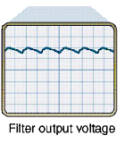
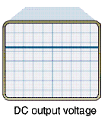
Block diagram of a Power Supply

Slide 19
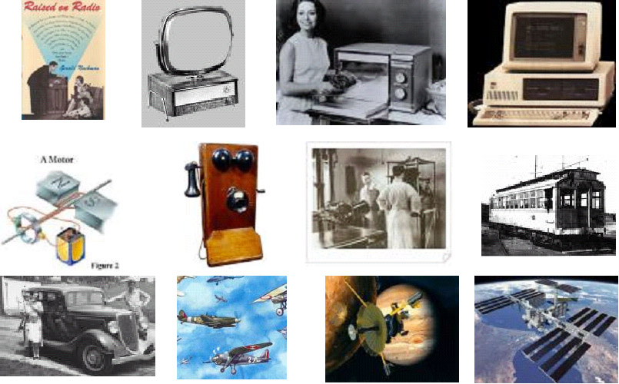
Fields?

Slide 20
Points to note…
The most important consideration in designing a power supply is the DC voltage at the output
It should be able to furnish the maximum current needed ,maintaining the voltage at constatnt level

Slide 21
Contd…
The AC ripple should be low
The power supply should be protect in the event of short circuit on the load side
The response of the power supply to temperature changes should be minimum

Slide 22
Filter Circuits
The output from the rectifier section is a pulsating DC.
The filter circuit reduces the peak-to-peak pulses to a small ripple voltage.

Slide 23
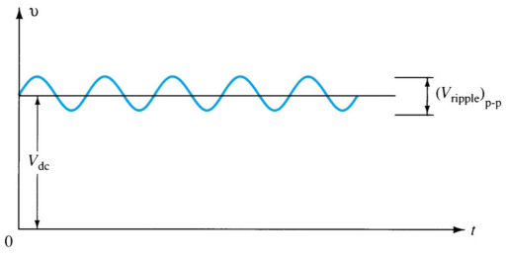
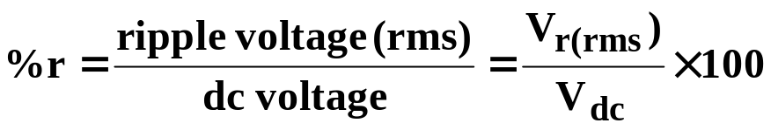
Ripple Factor
After the filter circuit a small amount of AC is still remaining. The amount of ripple voltage can be rated in terms of ripple factor (r).

Slide 24




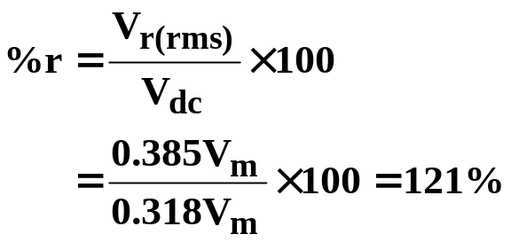
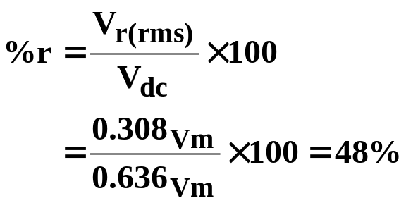
Rectifier Ripple Factor
Half-Wave
Full-Wave
DC output:
DC output:
AC ripple output:
AC ripple output:
Ripple factor:
Ripple factor:

Slide 25
Types of Filter Circuits
Capacitor Filter
RC Filter

Slide 26
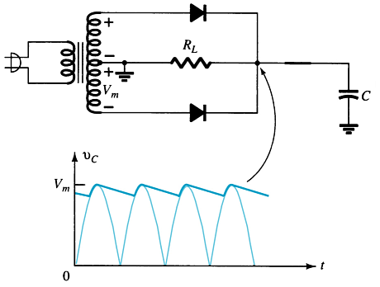
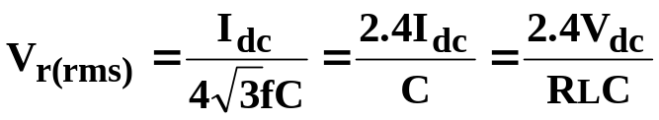
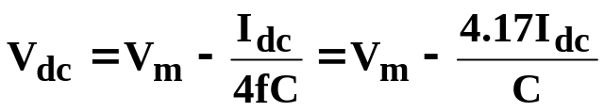
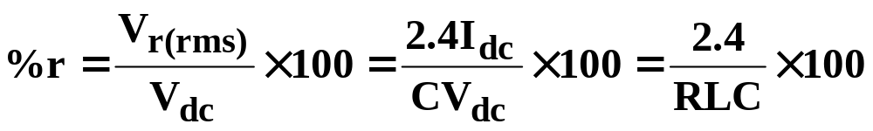
Capacitor Filter
Ripple voltage
The larger the capacitor the smaller the ripple voltage.
DC output
Ripple factor

Slide 27
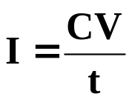
Diode Ratings with Capacitor Filter
The size of the capacitor increases the current drawn through the diodes—the larger the capacitance, the greater the amount of current.
Peak Current vs. Capacitance:
where
  C = capacitance
  V = change in capacitor voltage during charge/discharge
  t = the charge/discharge time

Slide 28
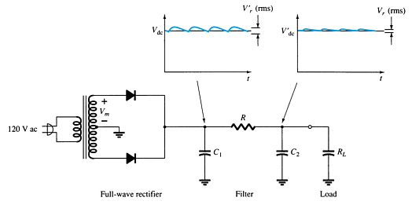
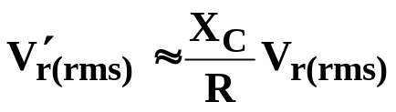
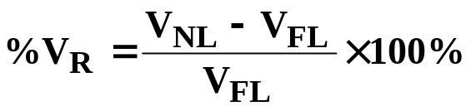
RC Filter Circuit
Adding an RC section further reduces the ripple voltage and decrease the surge current through the diodes.
V′_{r(rms)} = ripple voltage after the RC filter
V_{r(rms)} = ripple voltage before the RC filter
R = resistor in the added RC filter
X_{C} = reactance of the capacitor in the added RC filter
V_{NL} = no-load voltage
V_{FL} = full-load voltage

Slide 29
Voltage Regulation Circuits
There are two common types of circuitry for voltage regulation:
  Discrete Transistors
  IC’s

Slide 30
Discrete-Transistor Regulators
Series voltage regulator
Current-limiting circuit
Shunt voltage regulator

Slide 31
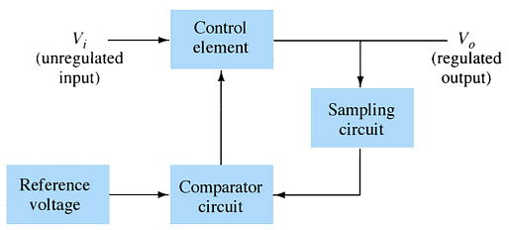
Series Voltage Regulator Circuit
The series element controls the amount of the input voltage that gets to the output.
If the output voltage increases (or decreases), the comparator circuit provides a control signal to cause the series control element to decrease (or increase) the amount of the output voltage.

Slide 32
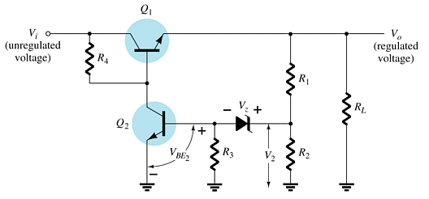
Series Voltage Regulator Circuit
R₁ and R₂ act as the sampling circuit
Zener provides the reference voltage
Q₂ controls the base current to Q₁
Q₁ maintains the constant output voltage
When the output increases:
  The voltage at V₂ and V_{BE} of Q₂ increases
  The conduction of Q₂ increases
  The conduction of Q₁ decreases
  The output voltage decreases
When the output decreases:
  The voltage at V₂ and V_{BE} of Q₂ decreases
  The conduction of Q₂ decreases
  The conduction of Q₁ increases
  The output voltage increases

Slide 33
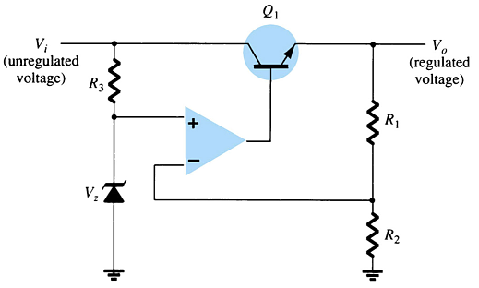
Series Voltage Regulator Circuit
The op-amp compares the Zener diode voltage with the output voltage (at R₁ and R₂) and controls the conduction of Q₁.

Slide 34
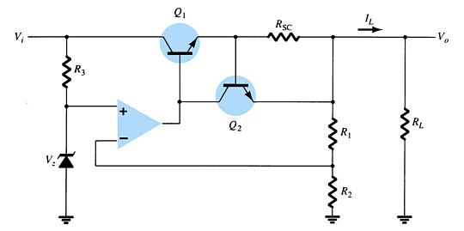
Current-Limiting Circuit
When I_{L} increases:
  The voltage across R_{SC} increases
  The increasing voltage across R_{SC} drives Q₂ on
  Conduction of Q₂ reduces current for Q₁ and the load

Slide 35
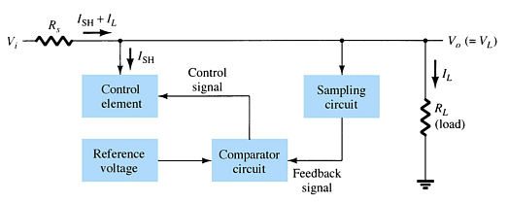
Shunt Voltage Regulator Circuit
The shunt voltage regulator shunts current away from the load.
The load voltage is sampled and fed back to a comparator circuit. If the load voltage is too high, control circuitry shunts more current away from the load.

Slide 36
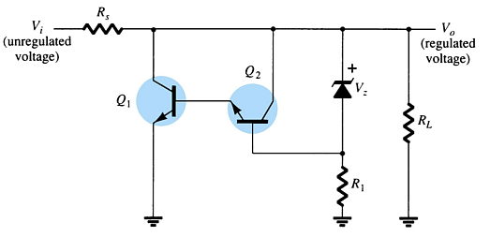
Shunt Voltage Regulator Circuit
When the output voltage increases:
  The Zener current increases
  The conduction of Q₂ increases
  The voltage drop at R_{s} increases
  The output voltage decreases
When the output voltage decreases:
  The Zener current decreases
  The conduction of Q₂ decreases
  The voltage drop at R_{s} decreases
  The output voltage increases

Slide 37
IC Voltage Regulators
Regulator ICs contain:
    Comparator circuit
    Reference voltage
    Control circuitry
    Overload protection
Types of three-terminal IC voltage regulators
    Fixed positive voltage regulator
    Fixed negative voltage regulator
    Adjustable voltage regulator

Slide 38
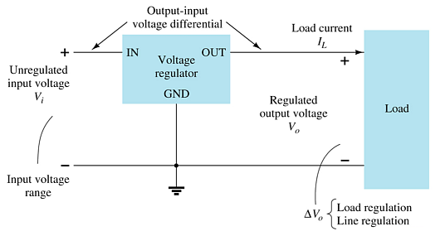
Three-Terminal Voltage Regulators
The specifications for this IC indicate:
  The range of input voltages that can be regulated for a specific range of output voltage and load current
  Load regulation—variation in output voltage with variations in load current
  Line regulation—variation in output voltage with variations in input voltage

Slide 39
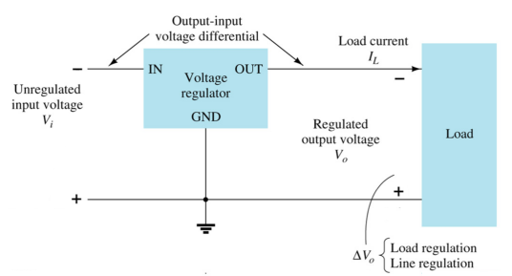
Fixed Negative Voltage Regulator
These ICs output a fixed negative output voltage.

Slide 40
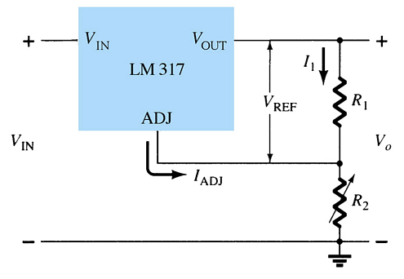
Adjustable Voltage Regulator
These regulators have adjustable output voltages.
The output voltage is commonly selected using a potentiometer.

Slide 41
Practical Power Supplies
DC supply (linear power supplies)
Chopper supply (switching power supplies)
TV horizontal high voltage supply
Battery chargers

Slide 42
        THANK YOU

